Slide 1

Wellcome
Mahbubur Rahman
Trainee ID: 1243838
Batch ID: J2EE/CCSL-M/37/01
Email: sakmahbub@gmail.com

Slide 2
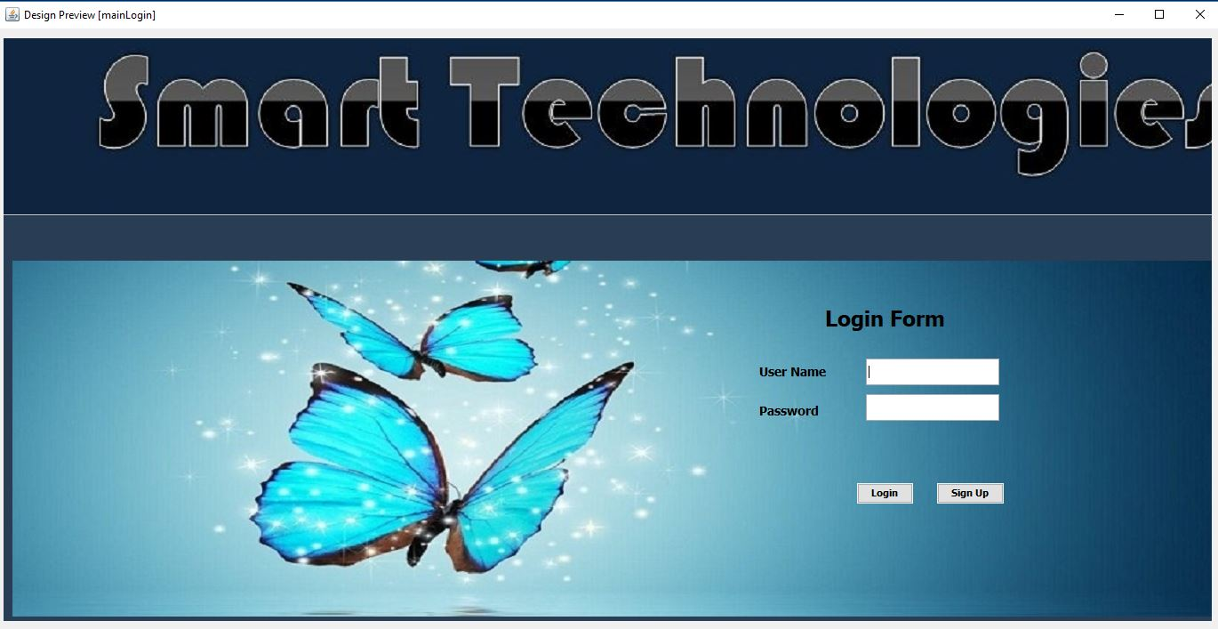
This is the Logion page of the INVENTORYCAL SYSTEM. When you open the Software the at the first time you see it.

Slide 3
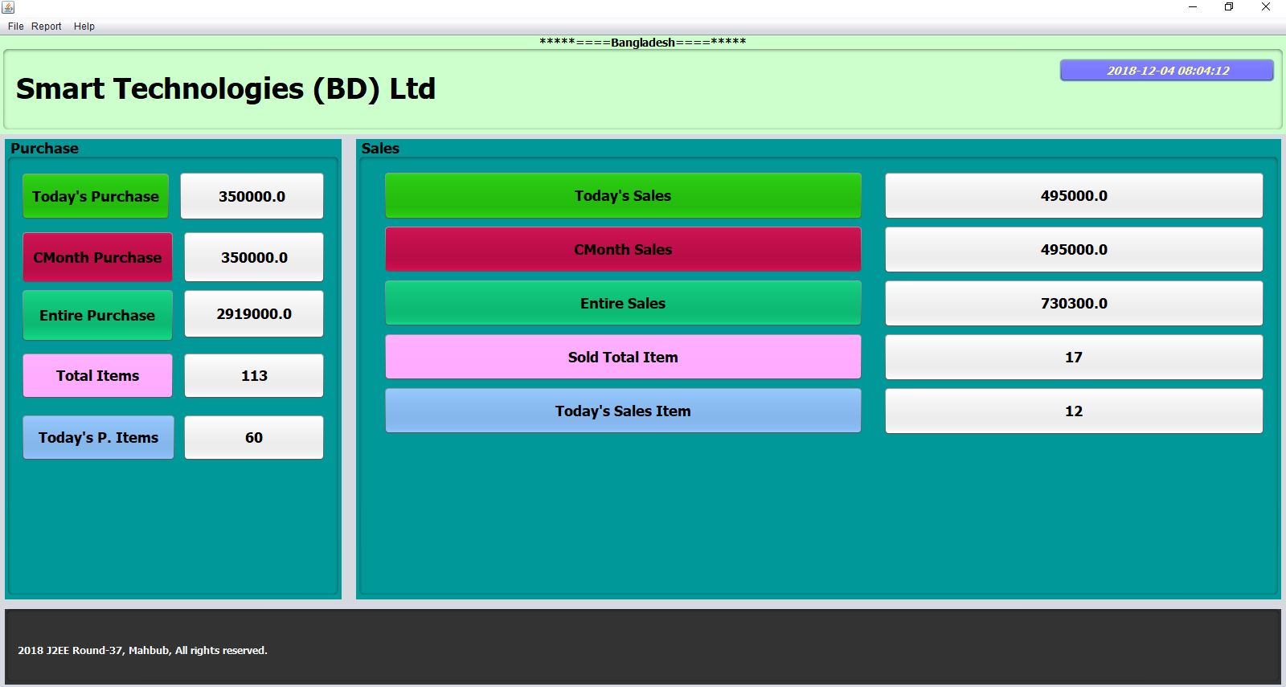
If you Successfully Logion then display the Dashboard page of overviewing the Management.

Slide 4
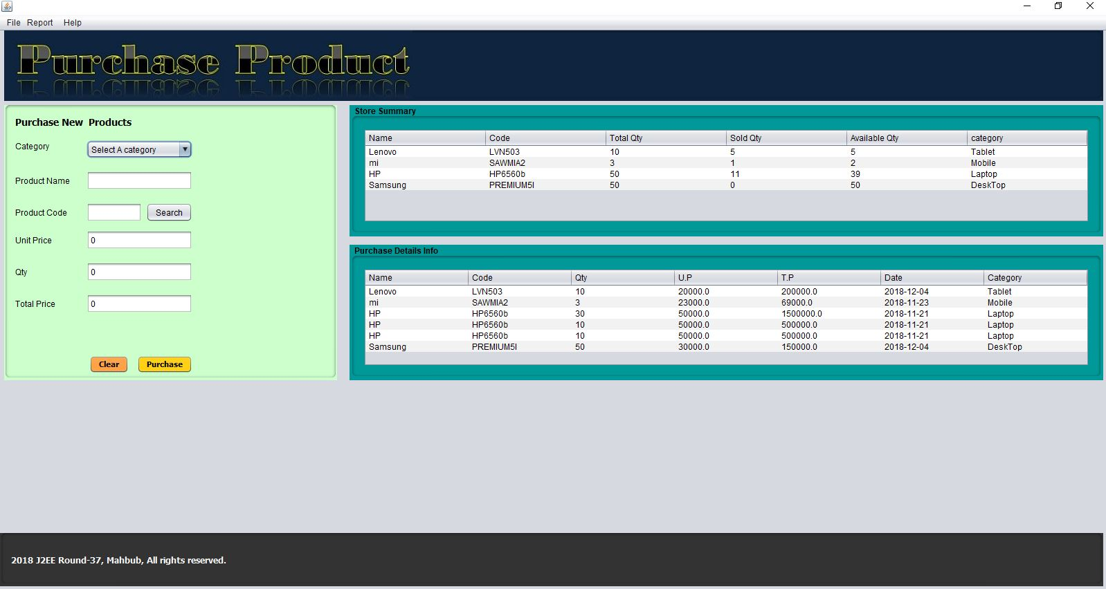
If you Admin, then See and handle the Purchase page. New Item Add new column but old item Update the column. Product Purchase Only Admin no Salesman.

Slide 5
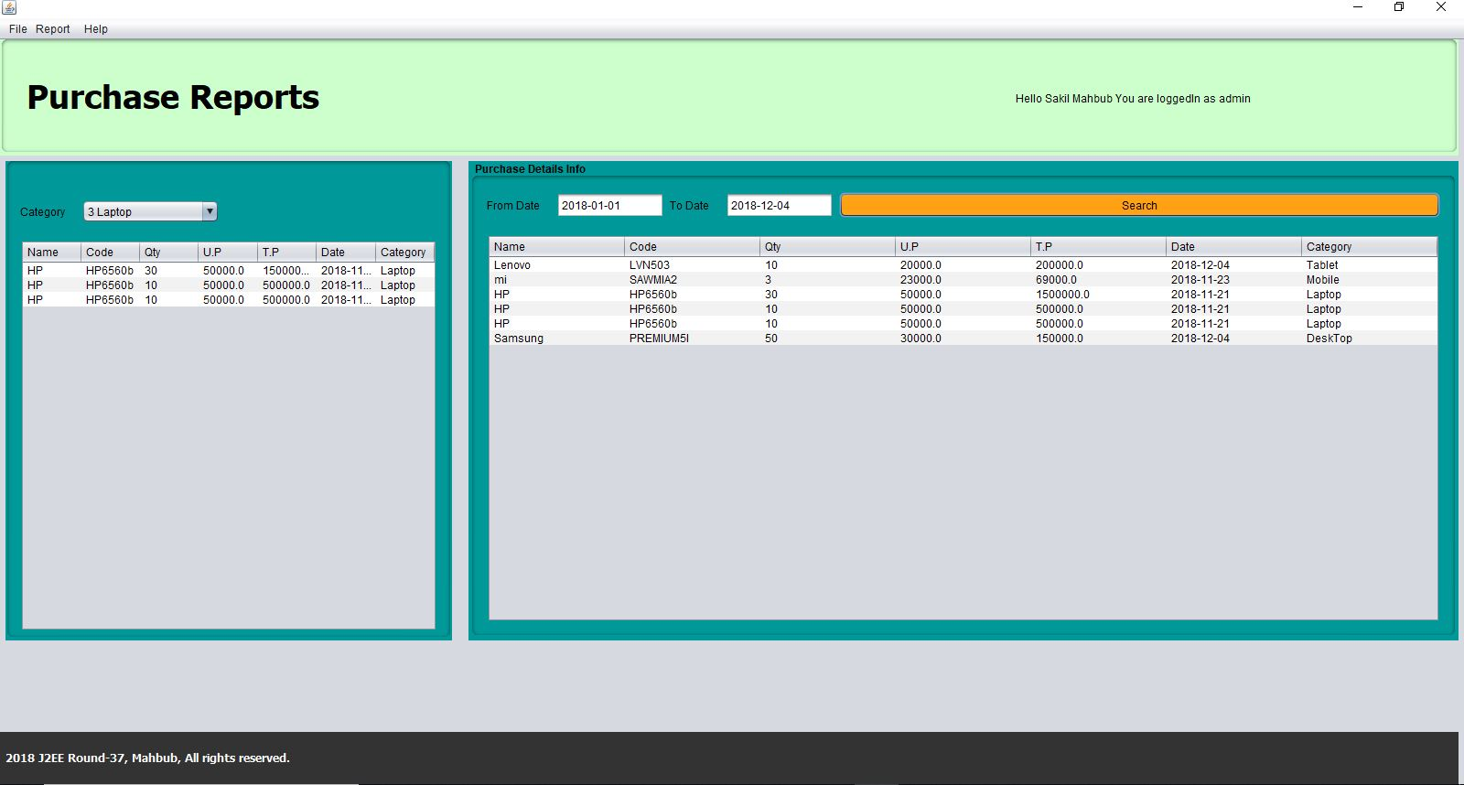
This is the Purchase Report page. You Can create purchase report All product Purchase Today or any date by the Search.

Slide 6
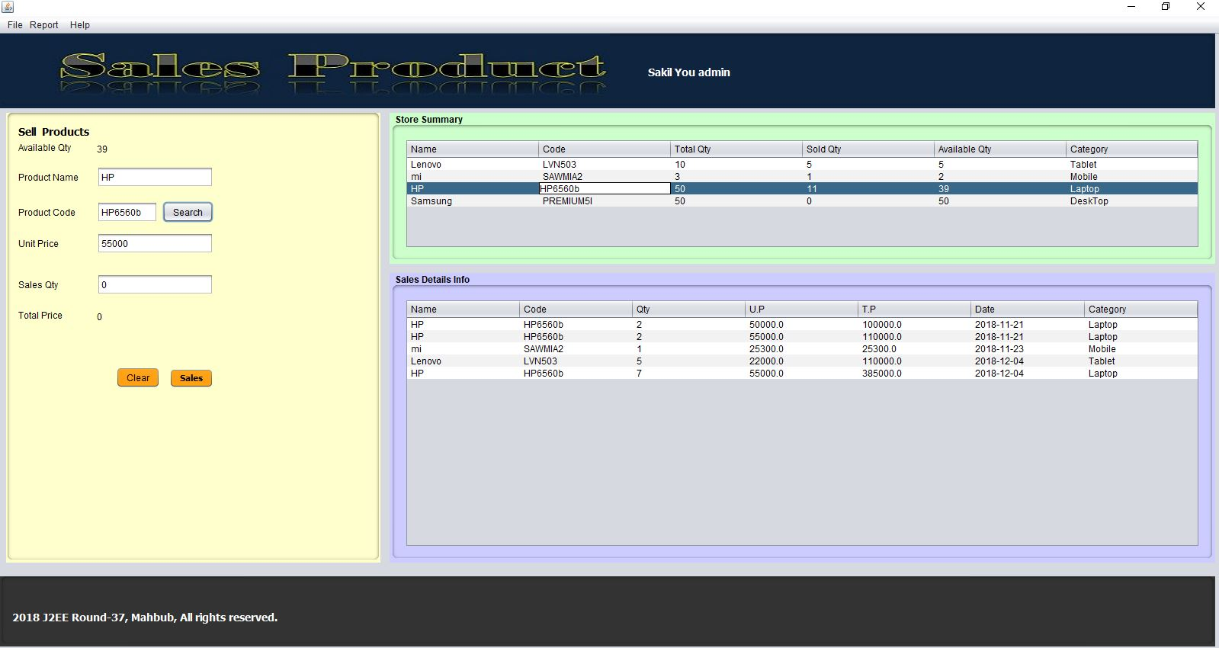
This is the Sales Product page. Sales any product Admin or salesman. How many product Available, sold and total Qty information in this page.

Slide 7
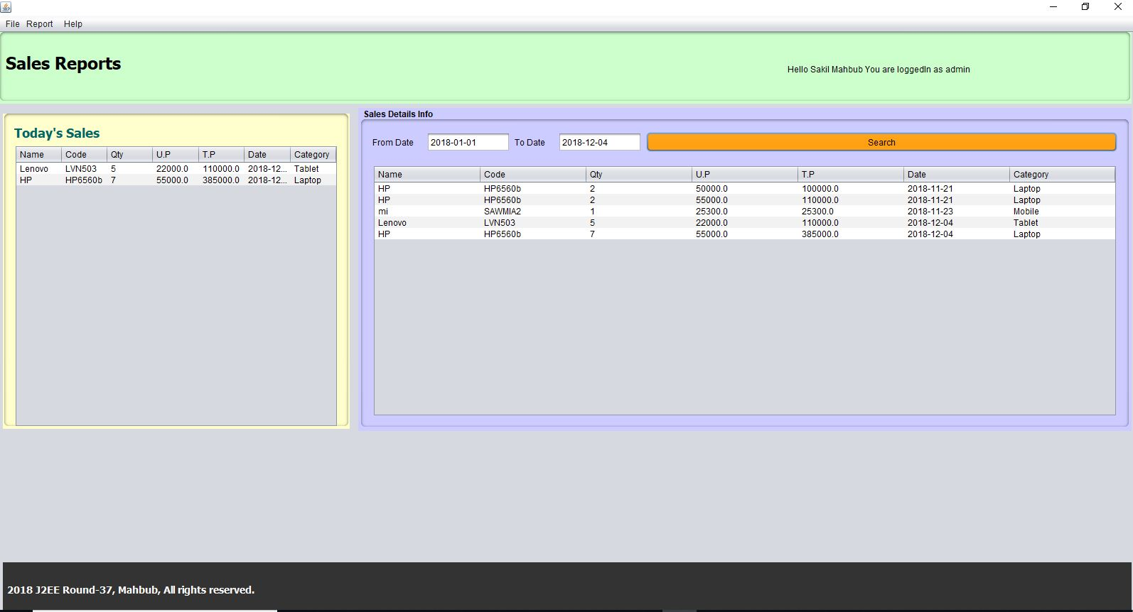
This is sales report page. You Can create sales report All product sales Today or others Day by the Search .

Slide 8
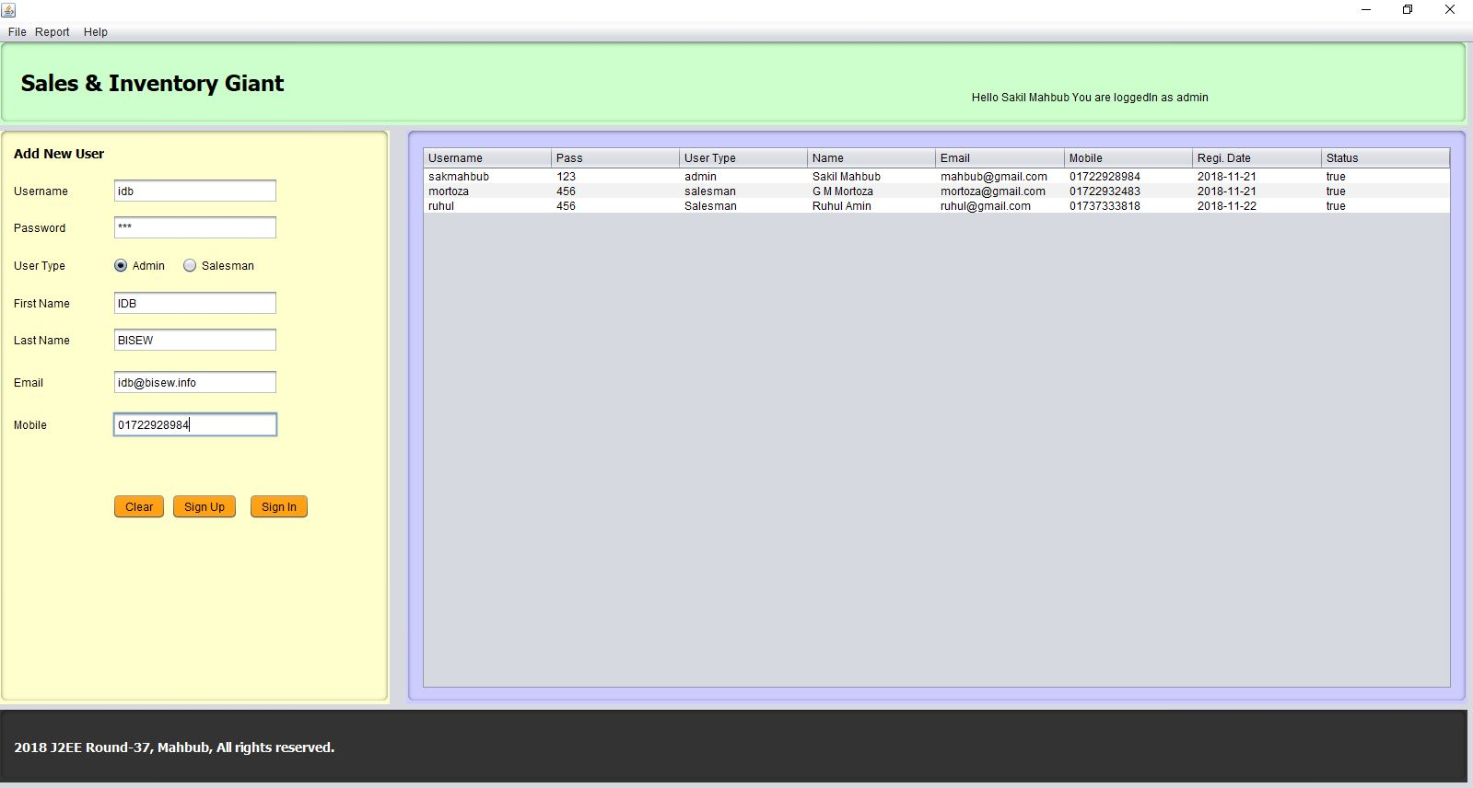
This is Add User (Admin/Salesman) page. When Don’t have your User Account, then use this page for sing up. Handle Only Admin.

Slide 9
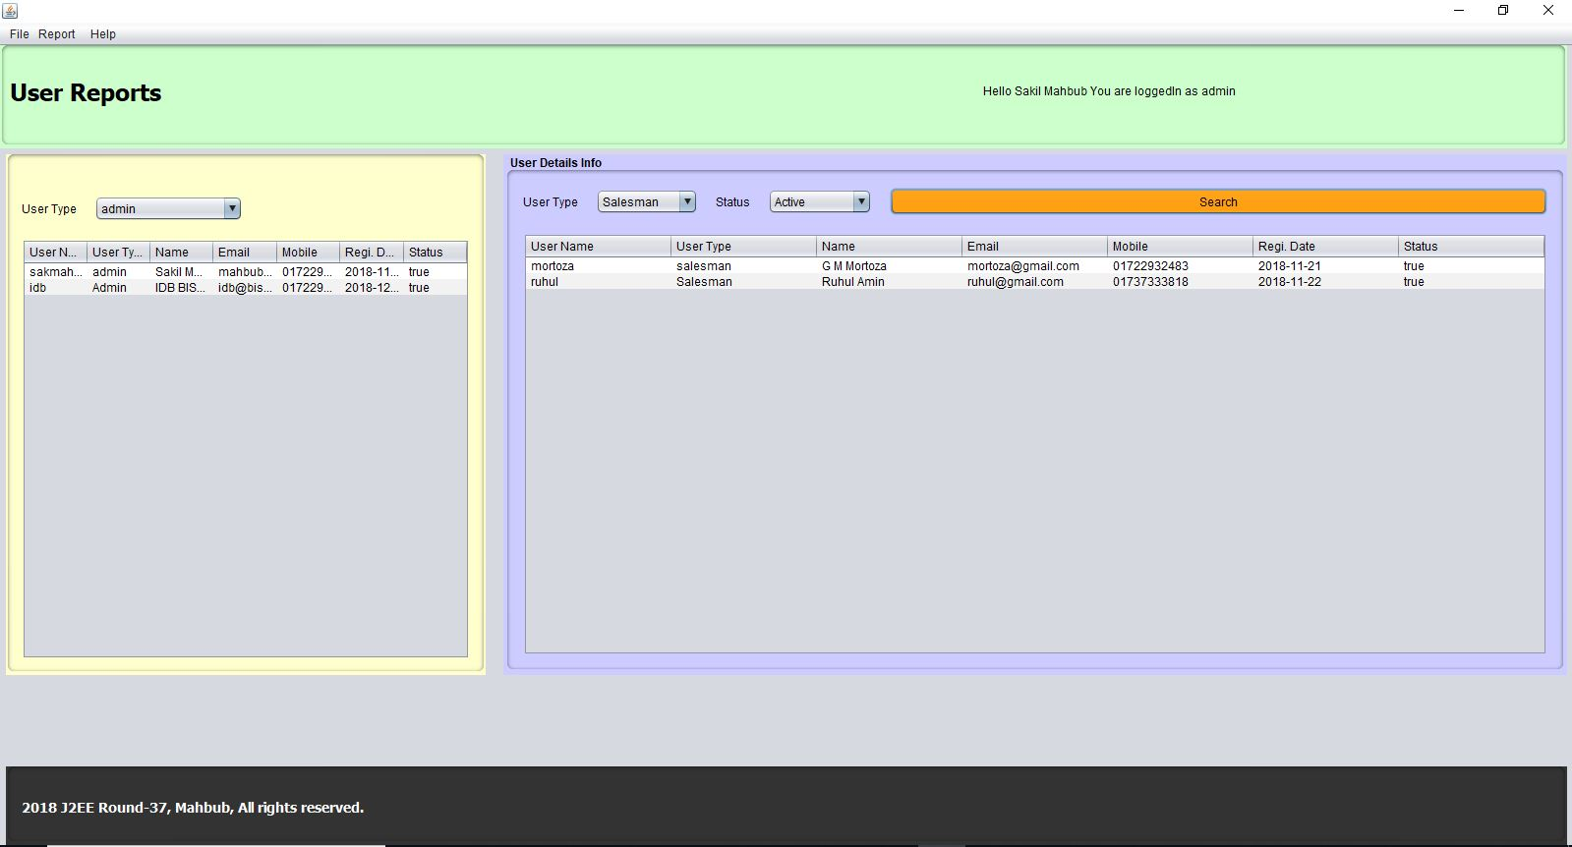
User Report page. Tell the page how many admin or salesman and who Active or Disable.

Slide 10
For visit INVENTORY MANAGEMENT SYSTEM.
Thank you Sir

